Slide 1
Why I think Kefir is interesting
By: Mohammadjavad Meghrazi

Slide 2
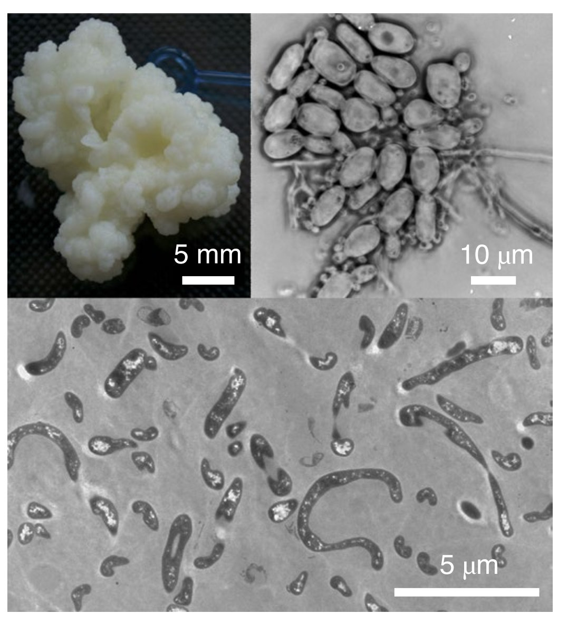
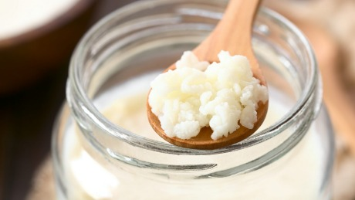
What is Kefir?

Slide 3
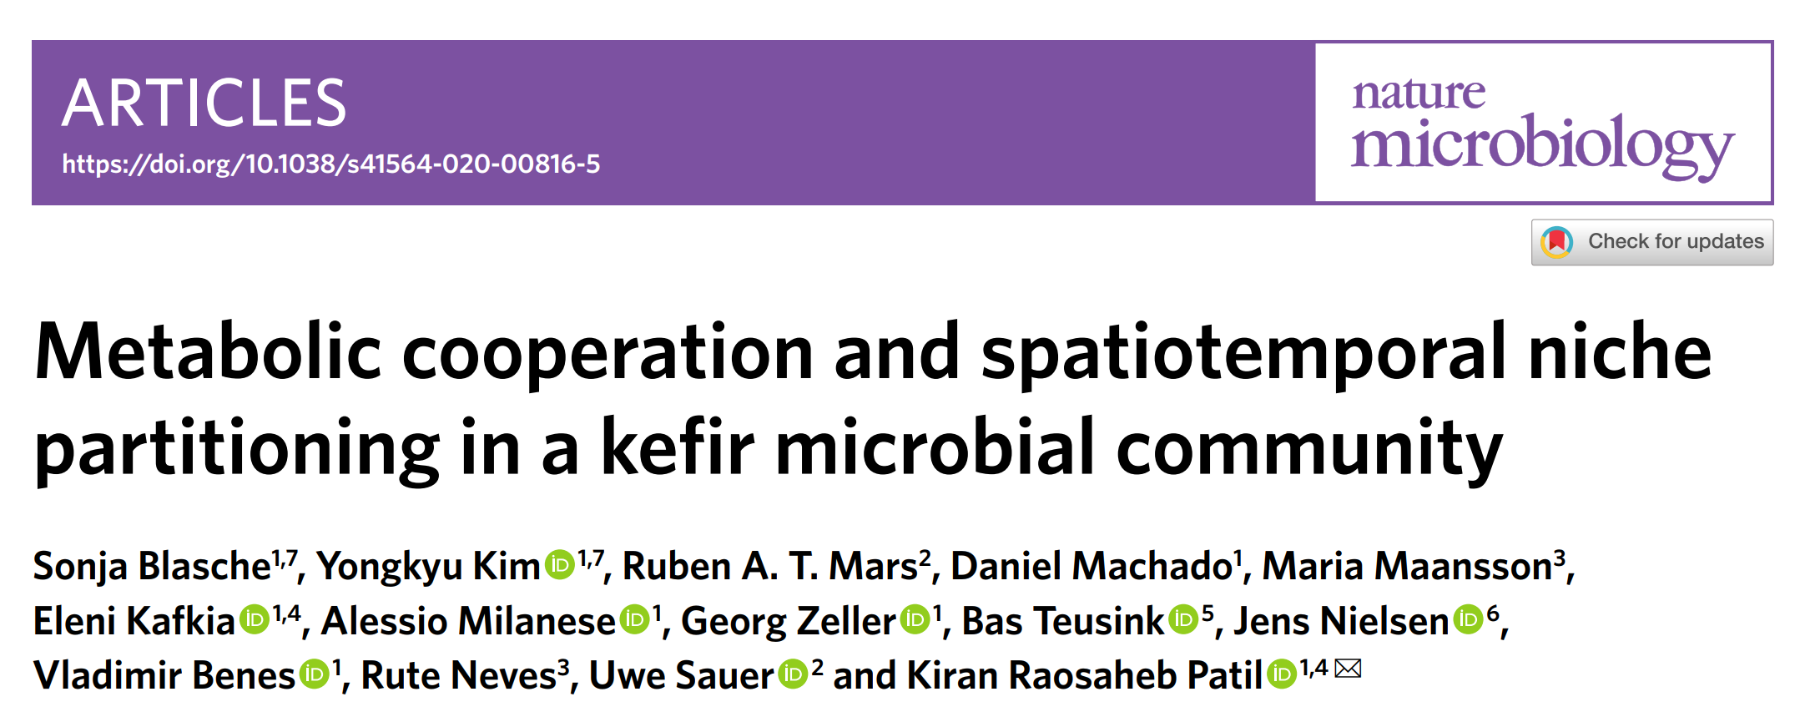
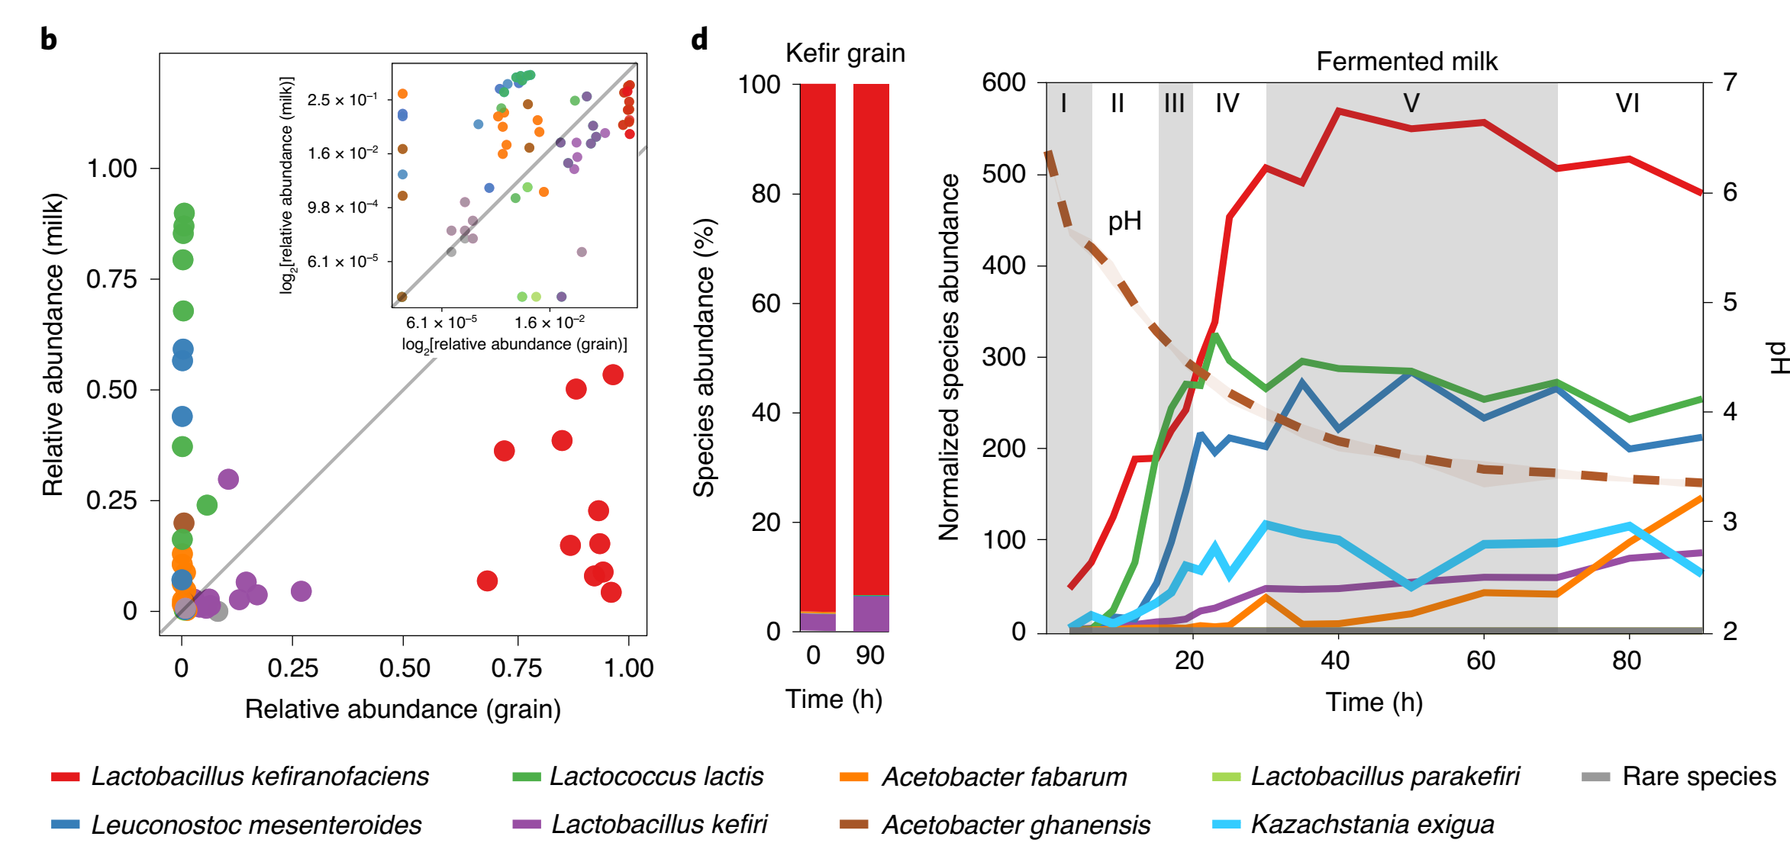
Interesting facts about Kefir

Slide 4
My questions:
https://lucid.app/lucidchart/46eeb6a7-3580-425e-9ef0-fe65723eceef/edit?page=0_0&invitationId=inv_97a08e9c-5b56-4c61-bd55-fa2395b9fed5#
A) Game theory
How/Why is Kefir resistant to cheaters (if really is?)
What is the role of fluctuating environment in eco-evolutionary dynamics? (if it plays an important role)
B) Community dynamics
How kefir is resistant to invasion?
How composition of species in grains remain almost constant?
C) Evolutionary engineering / de-novo synthesis
Can Kefir evolve to live in higher temperature (or on other carbon sources) and evolve community-level adaptations (not species-level)?
D) How has Kefir evolved?

Slide 5
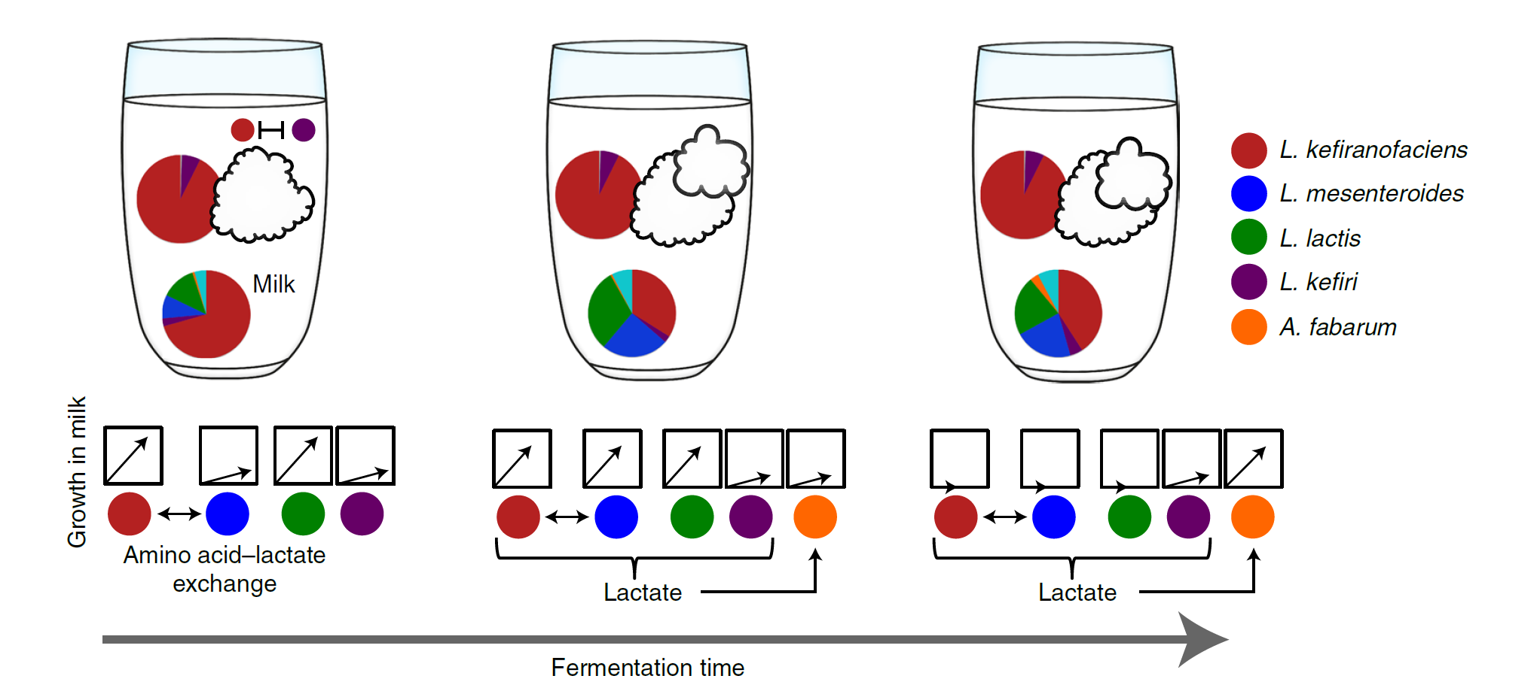
Is Kefir really a superorganism? Or it’s a multicellular LAB with a diffused gut!
Do bacteria that go into milk participate in the formation of new grains? Otherwise they are like somatic cells!

Slide 6
Has group selection played a role in evolution of kefir?
L. Kefirofaciens producing polysaccharide has a benefit. But how they overcome cheaters?
Selection for grain production is probable. Is selection for grain production equivalent of group selection?
Does aggregation provide a framework for group selection?
Interesting fact: LABs and yeasts form aggregation when there is no shaking!

Slide 7
Can we explain evolution of Kefir without group selection?
LABs and yeasts form aggregation when there is no shaking! (reference)
Does aggregation provide a framework for group selection

Slide 8
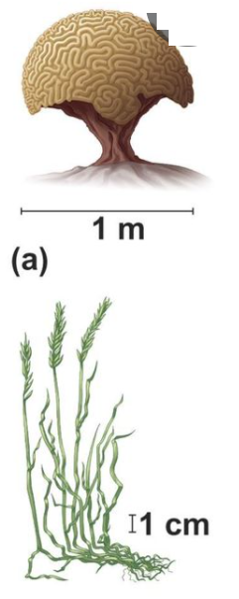
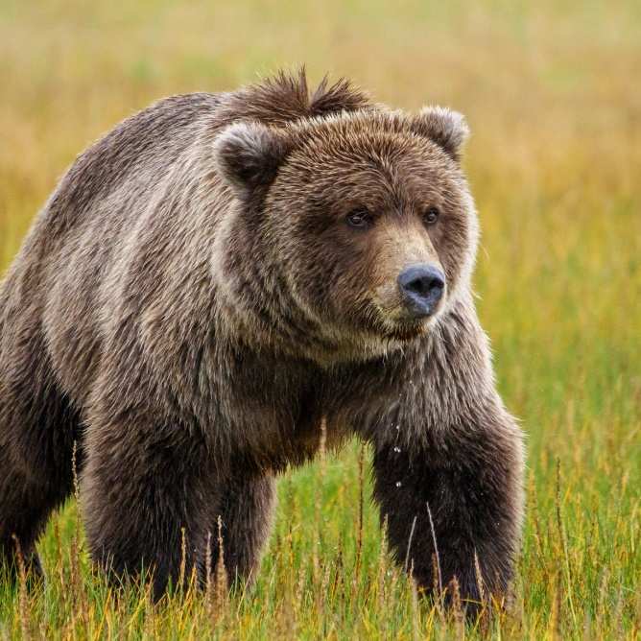
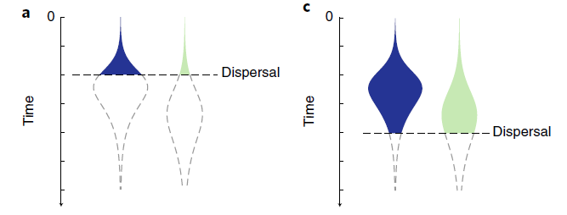
Modular vs Unitary group selection
Are principles of evolution different in Modular vs Unitary Multicellular organisms?
I “feel” that modular structure of kefir has a something to do with evolution of cooperation (in my defense, Lichen is modular)

Slide 9
Ecological vs Evolutionary community evolution
Notes:
Community composition is inheritable

Slide 10
Simpson’s paradox

Slide 11
Does drift play an important role in evolution of cooperation?

Slide 12

Model 3 (Oct 14) – a new version of model 1
${f′}_{A}=\frac{w_{A}}{\overline{w}} f_{A}$ ,, $g_{A}^{′}=\frac{x_{A}}{\overline{x}}g_{A}+μ_{A} ,, w_{A}=w_{wt}+s ,, x_{A}=x_{wt}−f_{A}z$
(I think it’s hard to write the math. At least I can’t. But’ it shouldn’t be super difficult to sumulate this)

Slide 13

Kefir Patch Model – Version 1
To investigate evolutionary community evolution
Limiting the df for frequency of mutation in the grain
$M_{t}=SDMGM_{t−1}$

Slide 14
Kefir Patch Model – version 2
Individual level resolution!
Link is in the lab meeting channel!

Slide 15
Model 4 – Matrix of different grain types
Assume there are n grain types, with different frequencies of mutations (n category of mutation frequency). If you have a vector containing weight of different grain types, you can model their growth by multiplying in a matrix accounting for selection, mutation, migration and drift?)
- make it soon and run simulations and then ask what’s the next question. Don’t wait long here. Also check Sally’s comments and try to continue model 3 in the direction that Sally said and see what will come to your mind.
- try to make more reasonable assumptions about the relationship between cheater frequency and grain fitness.
- are neighbors important?
what is the consequence of the frequencies in milk?

Slide 16
Feedback from Anna, Amy, Penny, Ali (Oct 18)
1- If we run a phylogenetic analysis (or maybe at functional-level) on Kefirs obtained from different origins can we observe meaningful patterns? (is the assumption of homology accurate?)
2- Anna: Are taxonomic groups important? Or only functions are important? Read Stillianous paper.
3- An interesting experiment would be (leh kardaning) kefir and make replicates to see if the composition of different grains are similar or not? (what determines the composition of grains? How ecological and evolutionary constraints interact?)
4- It’s counter-intuitive that u say both drift and selection are important (but I think at different levels). We should know how small the drift is?
5- The unit size is very important. How to determine it?

Slide 17
Interesting experiments
1- dissolve Kefir and see if it’s formed again
2- investigating formation of kefir in another side of the membrane which only allows individual microbes to cross.
3- Somehow understand if bacteria in milk participate in grain formation
I’m sooo afraid of starting experiments with Kefir!

Slide 18
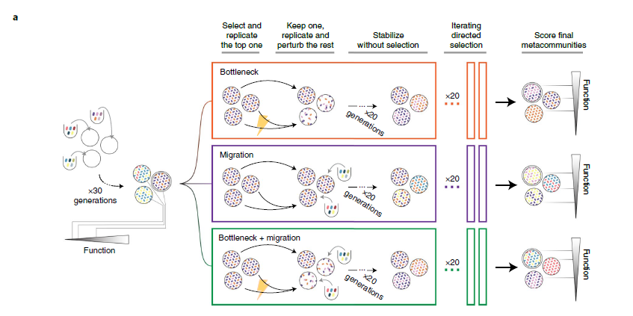
How to make predictions about Ecological community evolution?

Slide 19
An idea
I shouldn’t look for traits that are deleterious to the organism but beneficial for the grain. It’s possible that grains that are better survive but organisms that are in grain do not do any cooperation. Maybe a gain, composed of competing species is the best and most robust group. (I should both consider rate of grain growth and grain stability?) (how should I combine milk and grain? It would be much more complex in milk) even in grain it would be very complex when conditions are changing. When the environment is changing something like kefir can grow without the condition of having a dominant eigenvalue

Slide 20
My questions at the moment
1- How mutations that affect grain growth differently (different curves) affect the result of patch model. How they alter importance of drift?
2- Is evolution affecting different members of the grain in a similar way? If it’s different how is it different?
3- “It’s not hard for cooperation to approach fixation. It’s hard to prevent cheating!” is it true?
4- Can I define growth of the grain as function of growth of individuals? (combine grain growth and birth-death process)
5- If we put Kefir in higher temperatures (or under any other stress), does group selection improve the range of possible adaptations or it could limit ability of individual selection in achieving adaptation.
6- I’ve heard that diploidy has an important effect on evolution of multicellularity (because of masking mutations). Is ploidy-level also important in Kefir?

Slide 21
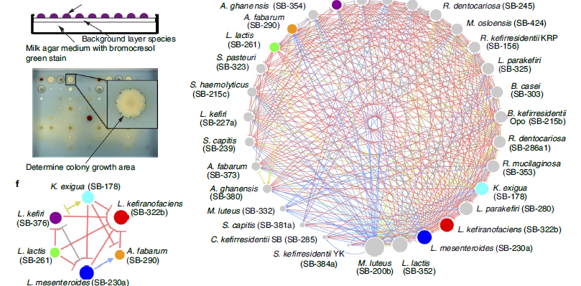

Slide 22
What is interesting about Kefir for you?

Slide 23
References

